Slide 1
Slides - Set 4: Water, Water Quality, Water and Wastewater Treatment
What does the prescribed Syllabus say about it?
2. WATER POLLUTION: Rainfall-runoff relationship; Groundwater, contamination and prevention; Water quality in lakes and reservoirs; Oxygen transfer in water bodies, DO and BOD; Concept of watershed management; Water quality standards; Assessment of water quality; Sources of water pollution; Classification of water pollutants; Effect of water pollutants; Self-purification of natural streams.
WATER AND WASTEWATER TREATMENT: Water Treatment – Necessity; Sedimentation, coagulation, filtration; Disinfection; Other methods; Rural water supply. Wastewater Treatment – Characteristics of sewage and common industrial wastewater; Primary treatment; Biological treatment, commonly used aerobic and anaerobic treatment; Sludge treatment and disposal; Disposal of treated effluent.
The focus will be on the current state of affairs in India and in the world, the policies in our country, the relevant laws and rules, water pollution control, introductory discussion on water and wastewater treatment

Slide 2
Water Pollution
The Act on Water Pollution: Water (Prevention and Control of Pollution) Act, 1974 is the relevant law in India. This is the first act on pollution control and environmental protection in our country. Central and State Pollution Control Boards (CPCB and SPCB’s) were established in India under the provisions of this Act. The Act empowers the Boards to collect water samples from different water bodies and industrial and trade effluents and analyze them to find out if the quality conforms to the proscribed standards. Any non-compliance is to be dealt with as per law. Sampling protocols are defined therein.
As per the Act, water “pollution” means such contamination of water or such alteration of the physical, chemical or biological properties of water or such discharge of any sewage or trade effluent or of any other liquid, gaseous or solid substance into water (whether directly or indirectly) as may, or is likely to, create a nuisance or render such water harmful or injurious to public health or safety, or to domestic, commercial, industrial, agricultural or other legitimate uses, or to the life and health of animals or plants or of aquatic organisms.
Major Sources of Water Pollution: Water quality may be deteriorated by a variety of reasons. Major sources are
Municipal Sewage: It contains different kinds of organics (both biodegradable and non-biodegradable), suspended solids and toxic substances. Leachates from municipal and industrial solid waste dumping/landfills can cause severe pollution if proper preventive actions are not taken.
Industrial Wastewater and Effluents: It may contain organics, suspended materials, oils and grease, hazardous and toxic substances. However, industries are not allowed to discharge untreated wastewater. They have to treat the water properly so that the final effluents reaching sewers or waterbodies meet the prescribed standards.
Agricultural sources: Fertilizers and insecticides/pesticides are routinely used in agricultural fields. Some of these substances reach the nearby waterbodies through agricultural run-offs. Nitrates and phosphates in waterbodies generally have their origin in such run-offs.

Slide 3
Spillage and Oil Leakage: Many incidents of spillage and leakage of oils occur each year polluting the water bodies, especially rivers and seas. There are many examples of leakage from oil tankers with disastrous effects on water quality and marine life. Oil spillage/leakage from off-shore oil production units, dumping of all kinds of wastes into waterbodies and seas is not uncommon and created pollution. Dumping of plastics, especially plastic microparticles used in many cosmetic products eventually reach rivers and seas causing serious pollution and harm to marine life. There are many examples of death of whales and sharks because of consumption of plastics. Dumping of solid wastes is another big source of water pollution.
Water Pollutants:
The more import pollutants are dissolved organics (expressed in terms of Biochemical Oxygen Demand, alternatively called biological oxygen demand, BOD; Chemical Oxygen Demand, COD); dissolved organics which are not easily biodegradable, called refractory or recalcitrant organics, Toxic and hazardous organics; Persistent Organic Pollutants, POP (this will be explained later); metal ions released from industries like metal working or electroplating industries; suspended solids; a variety of chemicals released from chemical industries; suspended oils and grease. Water pollutants are sometimes categorized as in another slide.
BOD is the amount of dissolved oxygen required by aerobic organisms to break down degradable organic materials in water expressed as mg/l of water. What is COD and DO?
Thermal Pollution becomes a serious one if hot water is discharged into water bodies. This happens with discharge of hot water from thermal power plants if water from local waterbodies or rivers is used for condensation of steam from the turbine and the hot water is pumped back to water bodies. This can cause disastrous effects on marine animals organisms.

Slide 4
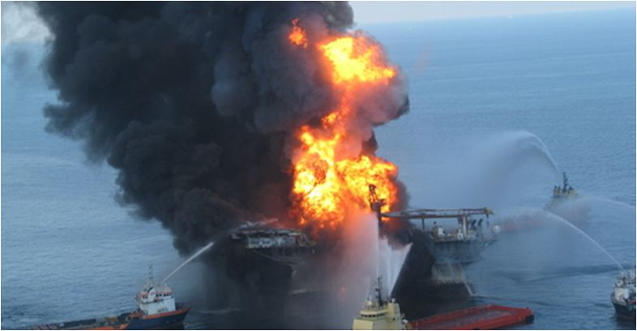
Examples of Oil Spill 2010 oil spill in the Gulf of Mexico, at British petroleum Oil Rig
An oil rig named Deepwater Horizon exploded in the Gulf of Mexico on April 20, 2010.
Eleven people working there died.
The explosion caused oil to begin leaking out. It leaked for 87 days.
In total, it leaked an estimated 94,000,000 to 184,000,000 gallons.

Slide 5
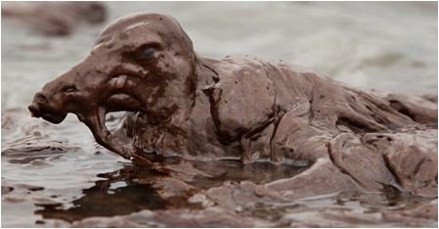
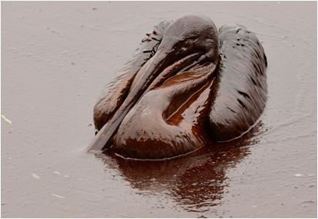
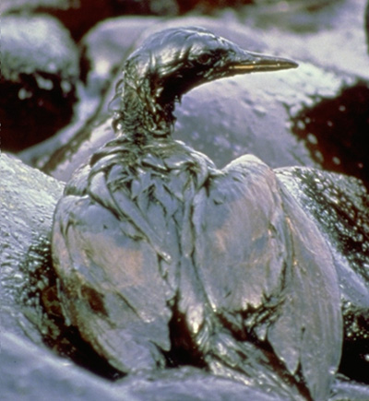
Sea Birds fully covered with crude oil at Gulf of Mexico.
BP was fined 20.8 billion$ by US Supreme Court.
An application of Polluter Pays Principle!
Exxon-Valdez Oil Spill, 1988
Supertanker Exxon Valdez, second newest in fleet, 987-feet, ran into the Bligh Reef in Prince William Sound, Alaska on March 24, 1989, at 9:12 p.m. 11 million gallons of crude oil spilled covering 1,300 miles of coastline and 11,000 square miles of ocean.
(a part of the sea bigger than a bay is called ‘sound’

Slide 6
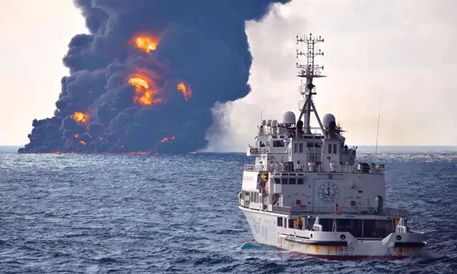
Burning Iranian Oil Tanker Sinks in East China Sea in January, 2018
Smoke and flames coming from the oil tanker The Sanchi at sea off the coast of China.
It burst into flames and sunk, eight days after a collision with a cargo ship off the coast of China.
Thirty crewmen died. Chinese officials have played down fears of a major environmental disaster.
The Sanchi was carrying 136,000 tonnes of light crude oil from Iran.
The smoke reached a height of 800-1000 meter

Slide 7
Categories of Water Pollutants
Infectious Agents
Bacteria, Viruses, Protozoa, Parasitic Worms Source:
Human and animal waste
Oxygen-Demanding Waste
Organic debris & waste + aerobic bacteria
Source: Sewage, feedlots, paper-mills, food processing
Inorganic Chemicals
Acids, Metals, Salts
Sources: Surface runoff, Industrial effluent,
Household cleansers
Radioactive Materials
Iodine, radon, uranium, cesium, thorium
Source: Coal & Nuclear Power plants, mining, weapons production, natural
Plant Nutrients
Nitrates, Phosphates,
Source: Sewage, manure, agricultural
and landscaping runoff
Organic Chemicals
Oil, Gasoline, Plastics, Pesticides, Solvents,
detergents Sources: Industrial effluent,
Household cleansers, runoff from farms and yards
Eroded Sediment
Soil, Silt
Heat/Thermal Pollution
Source: Power plants, Industrial
Lake Pollution
Dilution less effective than with streams
Stratification in lakes and relatively little flow hinder rapid dilution of pollutants
Lakes more vulnerable to pollutants than streams
How pollutants enter lakes
Eutrophication: causes and effects; Oligotrophic and eutrophic lakes; Cultural eutrophication
Preventing or removing eutrophication

Slide 8
Man-Made Water Pollution – an Example
Trash Truck Disposing of
Garbage into a River in Peru
Trash Truck Disposing of Garbage into a River in Peru g

Slide 9
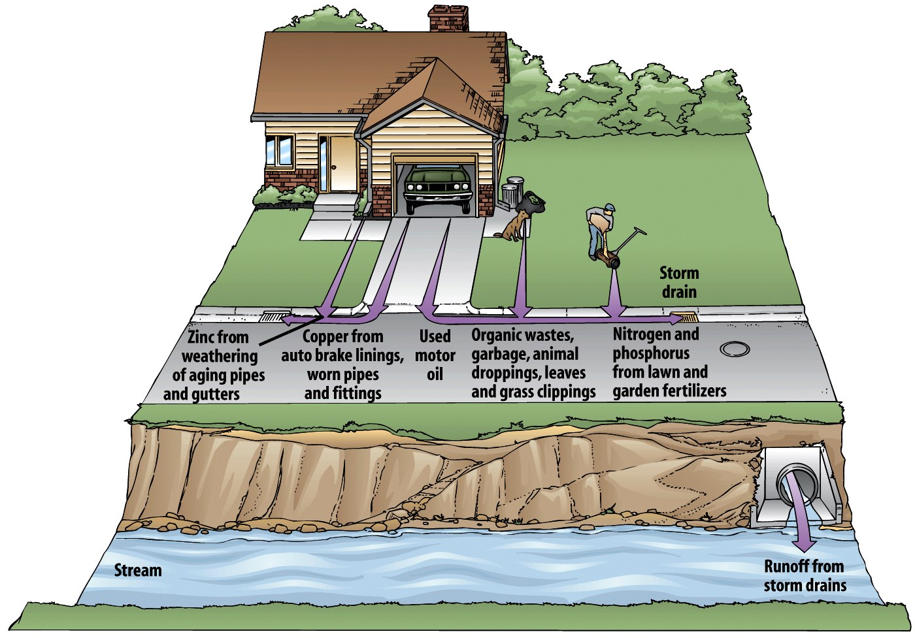
Sources of Municipal Water Pollution

Slide 10
Nonpoint sources
•Broad, diffuse areas
•Difficult to identify and control
•Expensive to clean up
•Examples
Point sources
•Located at specific places
•Easy to identify, monitor, and regulate
•Examples
Point Source and Non-Point Source Water Pollution
Illustrated

Slide 11
Dissolved Oxygen Profile and DO Sag in a Non-tidal River
3.33. (DO sag in a non-tidal river) Contamination of a natural water system (rivers, lakes, for example) is partly removed by self purification processes involving dilution, sedimentation and aeration. Wastewater containing biodegradable organics is often discharged into a river and this is a very important source of contamination. The oxygen demand for bacterial degradation of organics (called biochemical oxygen demand, BOD) is met by absorption of oxygen from air. Depletion of oxygen below about 5 ppm becomes critical for the aquatic life. A non-tidal river has a BOD load of L₀ (expressed as milligram oxygen required for biodegradation of the organics present in one litre wastewater) and a dissolved oxygen concentration w₀ (mg/l or g/m3) at a certain position (z = 0) along the river where the wastewater is discharged. The cross-section of the river (a, m2) is uniform and the average water velocity is u (m/s). The breadth of the river at the water surface is b (m).
As the water flows downstream, degradation of BOD continues following a first order kinetics, L_{t} = L₀exp(– kt), where L_{t} is the BOD in an element of water at a position z such that z = ut. This means that the rate of consumption of dissolved oxygen at the position z = ut is –d(L_{t})/dt. Absorption of oxygen occurs at the water surface, the mass transfer coefficient being kL (m/s). Over a certain distance from the reference point (z = 0), the rate of consumption of oxygen for biodegradation of orgaincs is usually more than the rate of its absorption from air. This causes a lowering of dissolved oxygen (DO) level, called the ‘DO sag’. But at a longer distance along the river, the BOD becomes lower (since much of it has already been removed), the oxygen consumption rate gets reduced, and the DO level builds up because of replenishment by absorption from air. Under such an idealized condition, a minimum DO should occur at some distance from z = 0. Develop a simple model for the process (called the ‘Streeter-Phelp model’) for the calculation of distribution of DO along the river and the point where the minimum of DO occurs (see G.M. Masters, Introduction to Environmental Engineering and Science,
Prentice Hall, New Delhi, 1991). A sketch of the system is given in Figure 3.16.

Slide 12
Solution already given in a file

Slide 13
Oxygen absorption from air (aeration)
Flowing water
BOD input
Dissolved oxygen profile
Dissolved oxygen deficit curve
Typical Dissolved Oxygen Deficit profile in a nontidal river with a point source of influent BOD

Slide 14
Persistent Organic Pollutants (POP’s)
These are liophilic chlorinated organic compounds which are hazardous and toxic and essentially non-biodegradable. They accumulate in animals and sometimes in plants through ingestion by virtue of their high lipid solubility. Thee compounds reach human and animal bodies through the food chain. There are many examples of disasters and death caused by ingestion of POP’s through the food chain.
Typical POP’s and their sources:
DDT (dichloro-diphenyl trichloro-ethane. It used to be a widely used insecticide. First synthesized in 1874. Its insecticidal properties were discovered by the Swiss chemist Paul Hermann Muller in 1939. It saw massive use to kill mosquitos in the warfronts of Africa during the second great war. It was used in agricultural fields and orchards for killing insects. Muller was awarded Nobel Prize in physiology and medicine in 1949 for this discovery.
However, its harmful effects on animals and human gradually came to light. Mounting evidences of birds and many other animals killed by ingestion of DDT through the food chain were enumerated in the book The Silent Spring by Rachel Carson published in 1962. Environmentalists raised their voice against use of DDT. Its use was banned in USA in 1972. It is now banned in many countries including India. Examples of appearance of DDT in cowmilk and even in breast milk have been reported.
Many of the POP’s are used as the active ingredients in insecticides. Examples: Aldrine, Dieldrine, Heptachlor, Endrine, Hexachloro-benzene (HCB, C₆H₆Cl₆), should be called hexachlorocyclohexane;
Tetra-chloro-dibenzo-p-dioxine (TCDD or simply Dioxine), generated from thermal degradation of chlorinated polymers such as polyvinyl-chloride (PVC);
Polychlorinated biphenyls (PCB’s) – these have very high thermal stability even at around 400oC. These were largely used as a transformer cooling liquid (often called cooling oil). Slow thermal degradation occurs and needed replacement from time to time. There are cases of used transformer liquid thrown in the open fields and death of cattle in firms by consumption of grass contaminated by PCB’s.

Slide 15
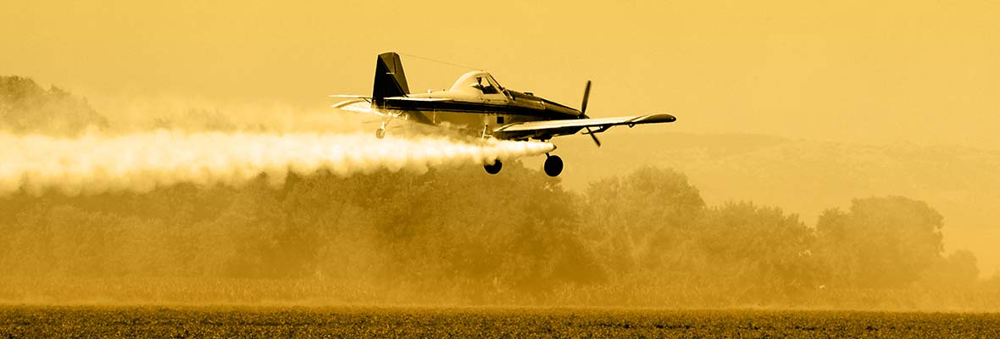
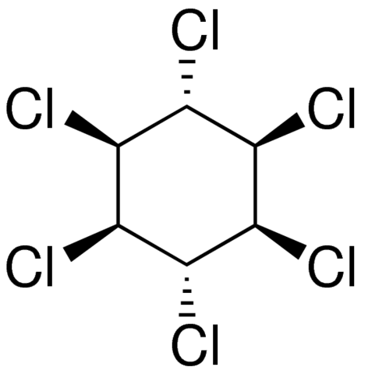
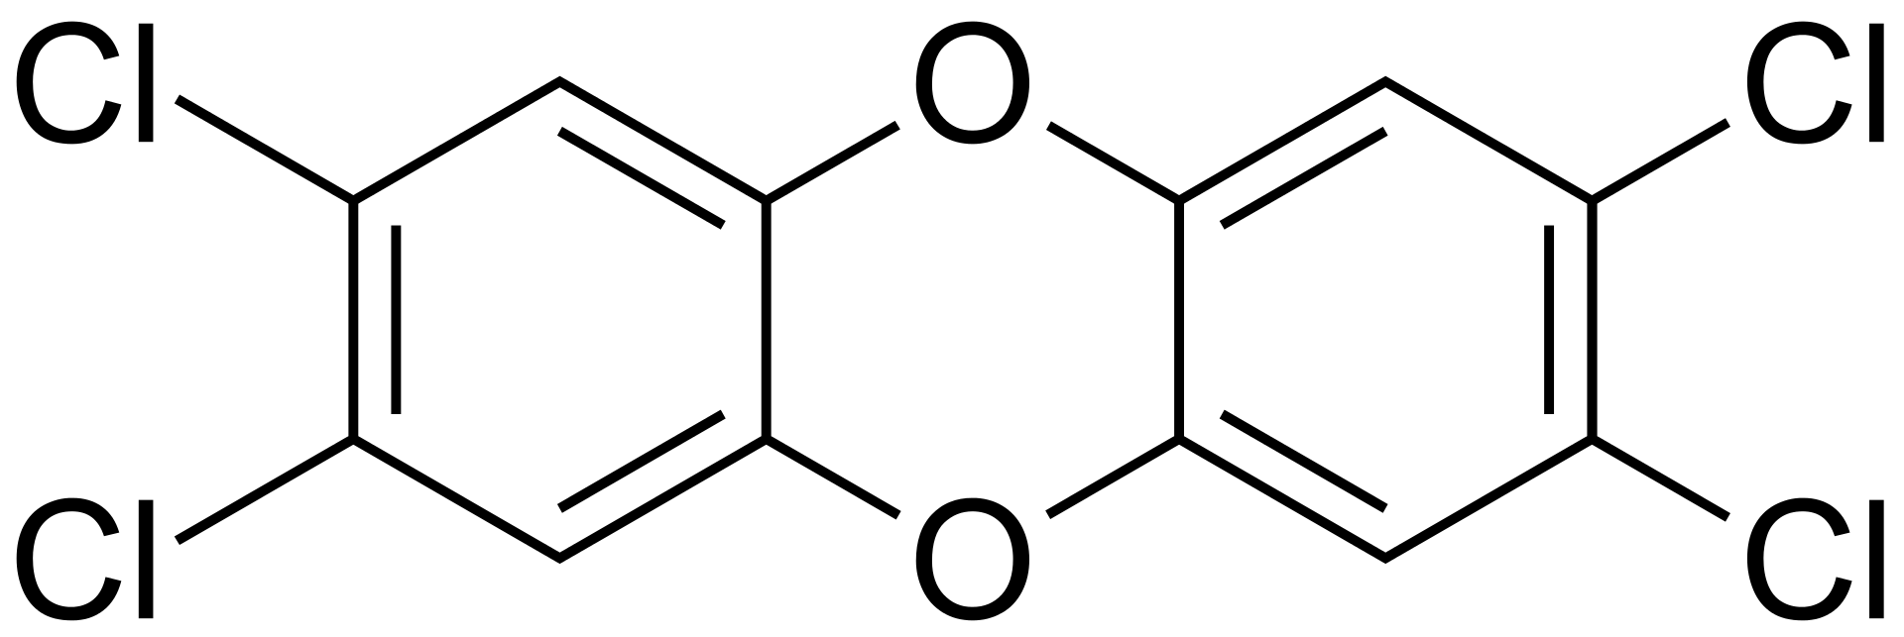
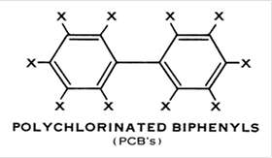
Insecticide sprayed from a plane
Gamma-Benzene Hexachloride
(active ingredient of the insecticide, Lindane)
Dioxine (TCDD)
PCB’s were detected in the great lake water, in sediments and in fishes
in the US. Lake Michigan was especially contaminated with PCB’s by water from its tributaries that carried the discarded PCB from the industrial areas since 1960’s.
Bioaccumulation and Biomagnification: Since the OPO’s are lipid soluble, they do not get dissolved in the excreted body fluid. As a result they continue to be ingested and accumulated in the body of the animal. This is called bioaccumulation. Further, when it passes on from one species to another through the food chain, its concentration increases. This is called biomagnification.
Regulation of POP’s is very important since it does not degrade. It rather keeps on accumulating deepening threat to Human and animals.
POP Convention of UNEP:
Because of the seriousness of the problem, a global convention was organized by UNEP at Stockholm in 2001 in order to formulate a strategy to regulate release of POP’s in the environment.

Slide 16
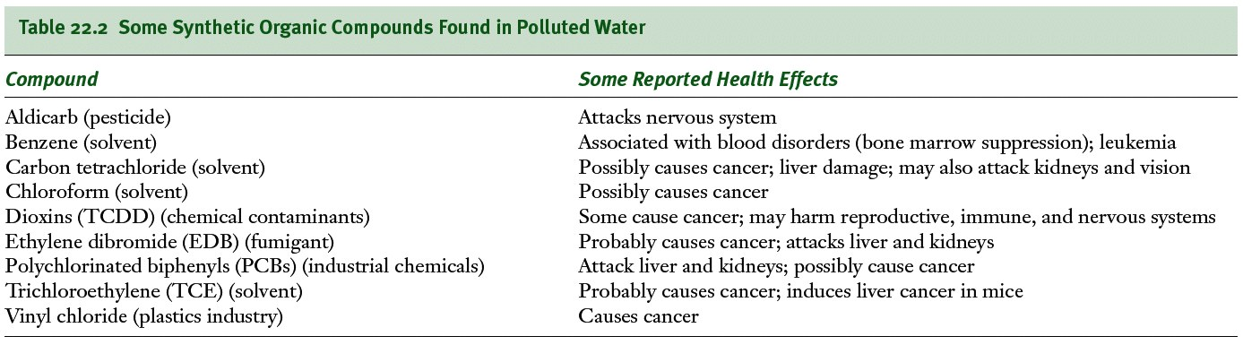
Lead Found in old paint, industrial pollutants, leaded gasoline
Mercury bioaccumulates in the muscles of top predators of the open ocean. Remember Minamata episode about the disaster caused by methyl mercury?
Persistent Organic Pollutants (POP’s)

Slide 17
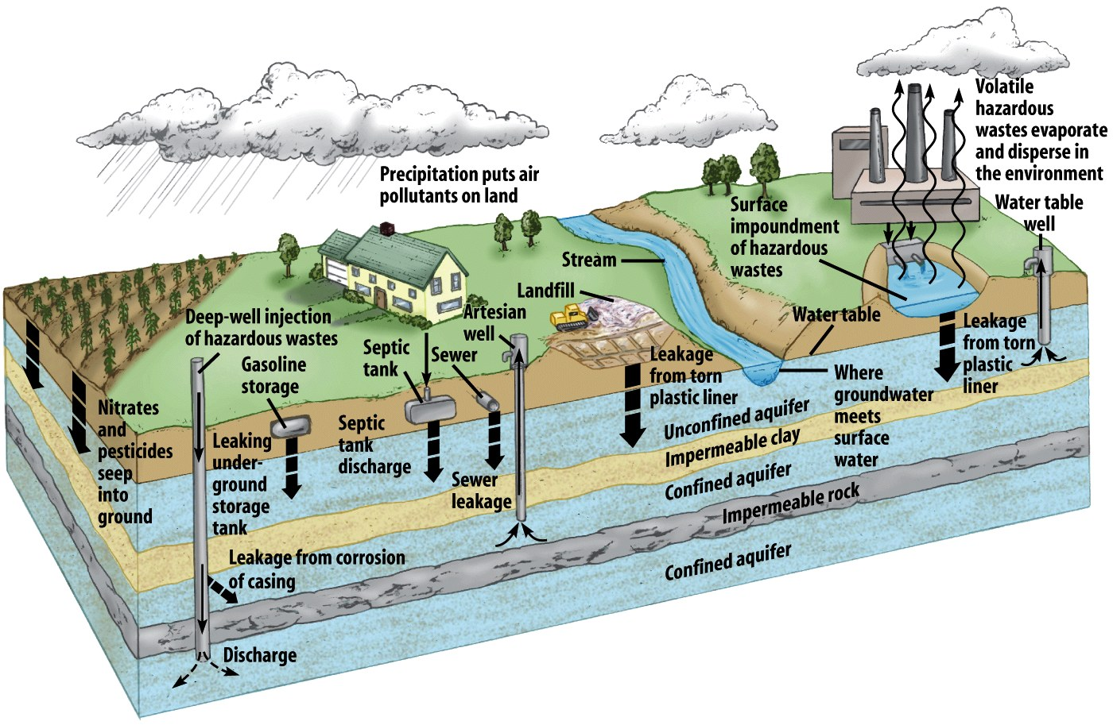
GROUND WATER POLLUTION - Different pathways

Slide 18
Ground Water Contamination
Pollutants found in Ground Water: Different type of metal ions and salts – Arsenic, Barium, manganese, Zinc, Fluorides (from leaching of naturally occurring minerals), Copper, Cadmium, Chromium, Sulfates, Cyanide (from industrial sources, electroplating wastes), Nitrates, pesticides (from agricultural sources); Volatile Organic Compounds (VOC’s); unacceptable physical characteristics – pH, Color, Odor, Turbidity, Coliform Bacteria.
Excessive nitrates in drinking is especially harmful to infants – high concentration of nitrates in drinking water get reduced to nitrites in the digestive tract. Nitrites react with oxyhemoglobin to form metheglobin that cannot carry oxygen causing oxygen deficiency in blood. This is called Blue Baby Syndrome.
Ground Water Pollution can occur because of natural processes as well as anthropogenic activities. The later can be point sources or non-point sources.
Natural Sources – Leaching of naturally occurring minerals, sea water intrusion causing increased salinity in ground water – excessive ground water withdrawal in the coastal regions causes a fall in the water table and intrusion of sea water which otherwise remain at some kind of equilibrium
Common anthropogenic sources - Leaching of open solid waste dump and percolation into ground water, intrusion of landfill leachate; septic tanks, injection of inferior quality water, leakage from underground storage tanks (VOC’s appear in ground water from leaking tanks); intrusion of agricultural and industrial wastes.

Slide 19
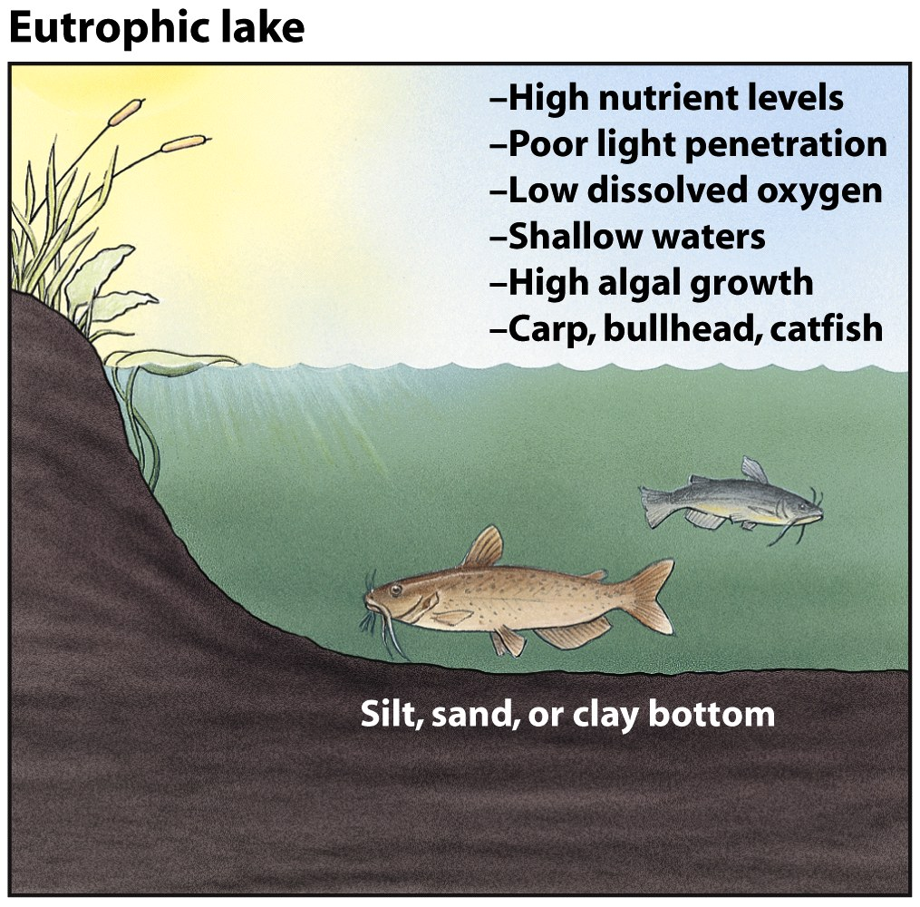
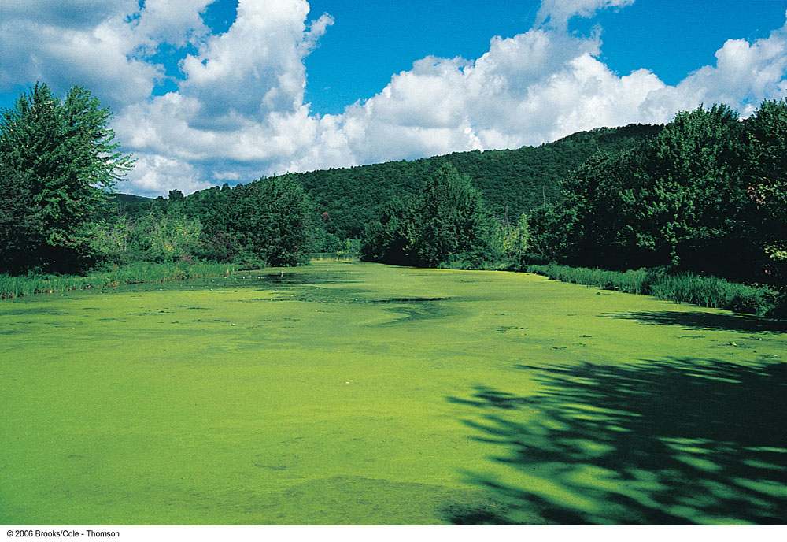
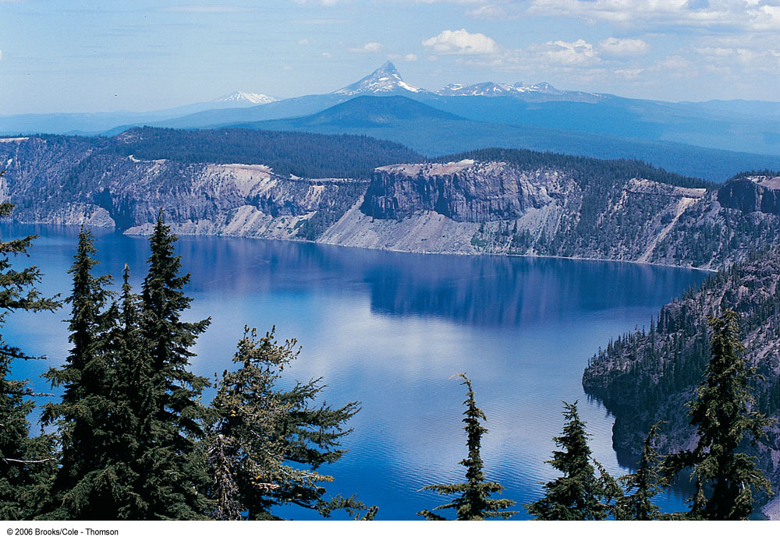
EUTROPHICATION OF WATER BODIES
It is a natural process of algal growth in presence of abundant supply of nutrients and micronutrients. The nutrients are carbon, nitrogen and phosphorus. Micronutrients are some metals and other compounds. These are supplied to the water bodies through the water it receives from municipal sewers or even industrial effluents.
An eutrophic lake has a higher productivity towards fish because of available food or algae. But, eutrophication lowers the dissolved oxygen in water, makes it turbid and shallow in course of time giving it a poor look. To reduce eutrophication, the nutrient supply should be reduced. However, productivity in terms of fish growth increases with eutrophication.
A waterbody is called Oligotrophic if if it has clear water, minimal algal growth because of dearth of nutrients. An oligotrophic lake can become eutrophic in course of time.
A Mesotrophic waterbody is one between oligotrophic and eutrophic.
Sediment Pollution
Excessive amounts of suspended soil particles
Originates from erosion of agricultural lands, forest soils exposed by logging, degraded stream banks, overgrazed rangelands, strip mines, and construction
Problems: Limits light penetration; Covers aquatic animals and plants
Brings insoluble toxins into waterways
Eutrophication can be reduced/controlled by preventing supply of nutrients through the influent water
Eutrophic
Oligotrophic
Oligotrophic and Eutrophic lakes

Slide 20
Quality of Water and Wastewater
Quality of Water (Drinking/Bathing) and Wastewater discharged after treatment (Effluent) are given in terms of prescribed standards issued by concerned Govt authorities in a country. Municipal Authorities have the responsibilities to ensure the quality of the water supplied for human consumption. Industries and Municipal authorities have to ensure that the discharge or effluents from the wastewater treatment units meet the effluent standards prescribed for this purpose. The Pollution Control Board of the area has to check the effluent quality from time to time and take regulatory action if there is “non-compliance” with the standards.
Methods and techniques for treatment of water for municipal supply as well as of treatment of wastewater (industrial or municipal) will be briefly discussed later.

Slide 21
Drinking Water Quality in India as per BIS 10500, 2012
For other parameters such as pesticides, refer to BIS 10500

Slide 22
Dissolved Oxygen (DO), Biochemical Oxygen Demand (BOD)
and Chemical Oxygen Demand (COD)
More common water quality parameters of water bodies (lakes, rivers) and effluents from Municipal Sewage Treatment Plants (STO’s) or industrial Effluent Treatment Plants (ETP’s) are : DO, BOD, COD, turbidity, color, pH, total suspended solids (TSS), total dissolved solids (TDS), dissolved metal ions/anions (such as heavy metals, Cyanide, chloride, sulphate, phosphate, et.
The water quality of a natural water body such as a lake or a river depends
largely upon the quality of waste water (municipal sewage, industrial effluents)
it receives as well as any solid wastes dumped into it. The process of natural purification
Can help to maintain the water quality to a limited extent primarily through
Bacterial oxidation with the help of microbes that exist in water. Atmospheric oxygen
That gets absorbed in water from air supply the oxygen demand for this purpose.
Oxygen is essential for survival and growth of aquatic animals such as fishes.
Oxygen-demanding organics (that biodegrade by microbial action) consume oxygen
in the process. The concentration of dissolved oxygen in water decreases in the process
Endangering survival of the aquatic animals. Absorption of oxygen from air (called
Re-aeration) may not solve the problem. This is why water quality standards limit the
Concentration of biodegradable organics (in terms of BOD) that can be discharged into
waterbodies from STP’s and ETP’s. The water quality parameters mentioned above are
Defined below.
Dissolved Oxygen (DO): DO in a waterbody occurs because of (i) absorption of oxygen
From air, and (ii) liberation of oxygen during photosynthesis in some aquatic plants.
Trash Truck Disposing of
Garbage into a River in Peru

Slide 23
DO, BOD, COD, etc Contd..
DO is the amount of dissolved oxygen in water expressed as mg O2 per liter of water (i.e., ppm O2 in water). Like other gases, solubility of oxygen in water depends upon partial pressure of oxygen and temperature. It can be calculated using the Henry’s law constant available in the literature. At 20ºC and 1 atm pressure (p_{O2} = 0.21 atm) the maximum DO value (or solubility) is 9.2 mg/liter. The requirement of DO by different marine animals and fishes vary. A DO value below 5 mg/L may affect normal aquatic life.
BOD is defined as the oxygen required to completely ‘oxidize’ the organic molecules in water to CO2 and H2O by microbial action. It is expressed as mg O2 per liter of water. It is determined by incubating a sealed sample of water (inoccculated with microbes) in a “BOD bottle” for five days at 20ºC and estimating the consumption of dissolved oxygen (the initial oxygen in water less the final oxygen per liter) after a five day incubation period. This is why it is called 5-day BOD or BOD₅. Example: If the initial DO in a BOD test is 8 mg/liter and the final (after 5 days) is 2 mg/liter, then the BOD of the sample is 6 mg/liter. The BOD value of the effluent from STP’s and ETP’s are regulated by environmental protection authorities so that the discharged water does not create a high dissolved oxygen demand in a waterbody jeopardizing aquatic life.
COD: The rate of microbial degradation of an organic in water varies. It is quick for some (e.g, sugar, fat) but slow for others (e.g., cellulose, hydrocarbons). For this reason, BOD does not properly describe the presence of organic in water. To overcome this problem, the parameter Chemical Oxygen Demand (CODD) has been introduced. It means the amount of oxygen required to degrade all organics, NH3 and nitrite etc in a sample of water expressed as mg O2 per liter. It is determined by Oxidizing all the organics in a measure volume of water by adding H2SO4 and K2Cr2O7, digest it under reflux for two hour and back titrate the excess dichromate. The oxygen consumed for oxidation of the organics (and some inorganics) can obtained from the results. This is COD.
Gadgets are available to measure these parameters without going through the titration method.

Slide 24
Water Quality Parameters Contd..
Turbidity: It is another water quality parameter. Turbid water has suspended particles in it and sometimes pathogetic bacteria may stick to the suspended particles. Also turbid water is aesthetically displeasing. Turbidity is measured by photometry (ie, by the fraction of incident light scattered by the particles in suspension). The standard for calibration of a turbidimeter is 1 mg/L of colloidal SiO2 = 1 normalized turbidity unit.
Color and Odor: Color is measured by comparison with light absorption of the sample water with a standard containing chloroplatinic acid. Odor is determine by dilution of an odorous water sample till odor cannot be detected.
Total Suspended Solids (TSS) and Total Dissolved Solids (TDS): TSS is determined by filtration of a known volume of water through a standard filter and weighing the dried solids. TDS is determined by evaporating a known volume of the filtered water and weighing the residue. Both are expressed in terms of mg per liter of water.
There are standard methods of estimation of different water quality parameters. The procedures described in
Standard Methods for the Examination of Water and Wastewater published by the American Water Works Association
Is commonly used.

Slide 25
Standards for Municipal and Industrial Effluents
Effluent Qualities and Standards are given in the Acts [Water Act, 1974 and EPA, 1986, and the Rules issued under the Acts from time to time through Gazette Notifications.
Following are the amended Standards for effluent water from a Municipal Sewage Treatment Plant (STP’s) prescribed only last year (2017)
pH; 6.5-9.0
BOD: 20 (maximum) for Certain Metro cities; 30 elsewhere
TSS (Total Suspended Solids): <50 for certain Metrocities; <100 elsewhere
Fecal Coliform: <1000 per 100 ml water
Reality: Many of the cities in India do not have Sewage Treatment Plants. Often non-functional or partly functional . Raw sewage from many cities and twons are discharged untreated to waterbodies or to land.
More about Fecal Coliform
These are facultatively anaerobic, non-sporulating rod-shaped Gram-negative bacteria.
Facultatively (facultative = optional, discretionary) anaerobic bacteria can use oxygen for metabolism but can also survive in anaerobic environment.
Non-sporulating Bacteria: They do not form ‘spores’. Bacterial Spores are highly resistant dormant structures (i.e., no metabolic activity) formed in response to adverse environmental conditions. Spore formation helps in survival of an organism in adverse environment.
Gram-negative and Gram-positive Bacteria: These are named after Hans Christian Gram (a medical doctor from Netherlands). Gram-positive bacteria has cell walls that can be stained by Crystal violet dye. Gram-negative Bacteria are not stained by Crystal Violet.
Gram-negative Bacteria are usually pathogenic (disease-causing).

Slide 26
Standards for Effluents from Effluent Treatment Plants (ETP’s) of industries
The effluent discharge standards are industry-specific and are issued by MoEFCC from time to time under the Environment Protection Act, 1986. The Standards for typical industries are given below so as to give an idea about it
Large Pulp and Paper Mills: BOD - 30; COD – 300-350 depending on certain factors; TSS – 500, all ppm
Sugar Industries: TSS – 100 for effluent discharged on land;
30 for discharge in surface water
BOD₃ - 100 for land discharge; 30 for discharge in surface water
Oil and Grease – 10
TSS – 2100
Total effluent discharge – 200 liter per tonne of cane crushed
Synthetic Rubber: BOD₃ - 50
COD - 250
Oil and grease - 10
Government pf India Gazette notifications give the effluent standards from time to time.

Slide 27
National Policies on Environment and Natural Resources
Government of India adopted a number of policies relating to the Environment, Natural Resources and Sustainable Development.
The National Environment Policy (NEP) was adopted in 2006. Its essential features are:
Conservation of Critical Environmental Resources: To protect and conserve critical environmental resources and invaluable natural and man- made heritage which are essential for life-supporting livelihoods and welfare of the society.
Inter-generational Equity: To ensure judicious use of environmental resources to meet the needs and aspirations of present and future generations.
Efficiency in Environmental Resources Use: To ensure efficient use of environmental resources in the sense of reduction in their use per unit of economic output and to minimize adverse environmental impacts on society.
Environmental Governance in the Management of Resources: To apply the principles of good governance (i.e. transparency, rationality, accountability, reduction in costs and time, and public participation) to the management of environmental resources.
Enhancement of Resources: Appropriate technology and traditional knowledgefor conservation and enhancement of resources.
Livelihood Security for the Poor: To ensure equitable access to environmental resources for poor tribal community.
Integration of Environmental Concerns for Socio-economic Development
National Water Policy was first adopted in 1987 and has been modified a few times The latest modification was done in 2002 highlights the importance of water for human existence as well as for all economic and development related activities. It addresses the problem of scarcity of water and the need to conserve this resource through optimal, economical, sustainable and equitable means.

Slide 28
Cleaning of the River Ganga, GAP, NGRBA and NMCG
This water quality of this arterial river has deteriorated tremendously over the years because of discharge of untreated industrial effluents and municipal sewage besides dumping of all kind of solid wastes including carcasses.
M C Mehta, a noted environmental lawyer and Magsaysay Awardee, lodged a Public Interest Litigation (PIL) in the Supreme court of India in 1985 drawing the attention of the apex Court to this issue of discharge of untreated effluents and solid wastes and poor water quality and seeking appropriate orders.
The Ganga Action Plan (GAP-1) was initiated with much fanfare in 1986. The objectives were to establish sewage and treatment plants all along the river stretch and to bring the water quality ot DO – 5 mg/L, BOD – 3 mg/L and Fecal Coliform – 2500 per 100 ml. [Fecal Coliform in the Ganga water now is of the order of 100,000. ] many STP’s were built but only a few functioned. Most of them were non-functional.
Ganga Action Plan Phase-II (GAP-II) started in the late 1990’s. Substantial improvement of water quality was claimed . Many more STP’s were built and renovated. Regulation on industries were strengthened. Monitoring of water quality got more attention.
To further enhance the efforts and activities, National Ganga River Basin Authority under the chairmanship of the Prime Minister of India was formed in 2009. Since then more action plans were undertaken. National Mission for Clean Ganga (NMCG) was formed. Huge funds were made available, much of it as loan from the World bank.
Many on-line water quality monitoring stations have been established along the river, industries have been forced to establish on-line effluent quality monitoring facility with data transmission to the CPCB server.
In a CPCB report of 2009, total sewage generation in Class I and Class II cities along the Ganga was estimated at 2670 million Liter per day (MLD) and the capacity of the STP’s at 1191 MLD (many of which are essentially nonfunctional!)
The water quality varies over the seasons mainly because of variation in flow. The minimum DO reported is below 2 mg/L, maximum BOD of over 25 (8 times the value allowable in bathing standards) and coliform as high as 30,00,000 (allowable limit 2500!!).

